Slide 1
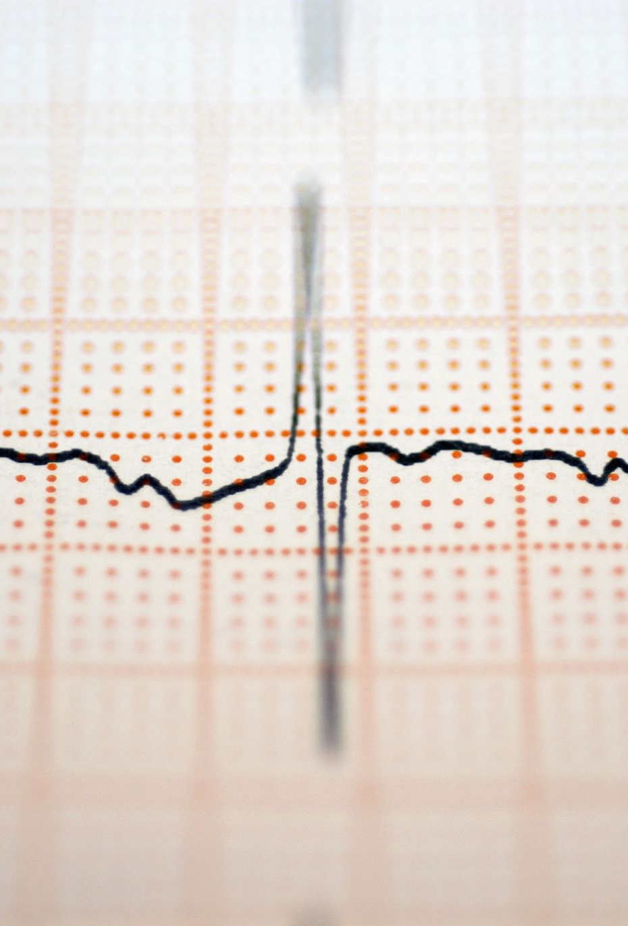
CAPSTONE PROJECT 3 Cardiovascular Risk Prediction
TEAM MEMBERS
AMITHA K
APOORVA VISHWAKARMA
ABHISHEK P SADAWARTE
MOHD KHALID
SHASHANK KUMAR YADAV

Slide 2
CONTENT
INTRODUCTION
PROBLEM STATEMENT
DATA SUMMARY
METHODOLOGY
EXPLORATORY DATA ANALYSIS
CONFUSION MATRIX
CHALLENGES FACED
CONCLUSION
Q AND A

Slide 3

INTRODUCTION
Cardiovascular disease (CVD) is a general term for conditions affecting the heart or blood vessels.
It's usually associated with a build-up of fatty deposits inside the arteries (atherosclerosis) and an increased risk of blood clots.
It can also be associated with damage to arteries in organs such as the brain, heart, kidneys and eyes.

Slide 4
INTRODUCTION
What are the main causes of coronary heart disease?
Smoking. Smoking is a major risk factor for coronary heart disease.
High blood pressure. High blood pressure (hypertension) puts a strain on your heart and can lead to CHD.
High cholesterol.
High lipoprotein (a)
Lack of regular exercise.
Diabetes.
Machine Learning is one of the slanting innovations utilized in numerous circles far and wide including the medicinal services application for predicting illnesses.
In this project, data of Framingham city is given.
The Framingham Heart Study is a long-term, ongoing cardiovascular cohort study of residents of the city of Framingham, Massachusetts.

Slide 5

PROBLEM STATEMENT
The dataset is from an ongoing cardiovascular study on residents of the town of Framingham, Massachusetts. The classification goal is to predict whether the patient has a 10-year risk of future coronary heart disease (CHD). The dataset provides the patients’ information. It includes over 4,000 records and 15 attributes. Variables Each attribute is a potential risk factor. There are both demographic, behavioral, and medical risk factors.

Slide 6
DATA SUMMARY
Demographic:
• Sex: male or female("M" or "F")
• Age: Age of the patient;(Continuous - Although the recorded ages have been truncated to whole numbers, the concept of age is continuous) Behavioral
• is_smoking: whether or not the patient is a current smoker ("YES" or "NO")
• Cigs Per Day: the number of cigarettes that the person smoked on average in one day.(can be considered continuous as one can have any number of cigarettes, even half a cigarette.) Medical( history)
• BP Meds: whether or not the patient was on blood pressure medication (Nominal)
• Prevalent Stroke: whether or not the patient had previously had a stroke (Nominal)
• Prevalent Hyp: whether or not the patient was hypertensive (Nominal)
• Diabetes: whether or not the patient had diabetes (Nominal)

Slide 7
DATA SUMMARY
Medical(current)
• Tot Chol: total cholesterol level (Continuous)
• Sys BP: systolic blood pressure (Continuous)
• Dia BP: diastolic blood pressure (Continuous)
• BMI: Body Mass Index (Continuous)
• Heart Rate: heart rate (Continuous - In medical research, variables such as heart rate though in fact discrete, yet are considered continuous because of large number of possible values.)
• Glucose: glucose level (Continuous) Predict variable (desired target)
• 10-year risk of coronary heart disease CHD(binary: “1”, means “Yes”, “0” means “No”) - DV

Slide 8
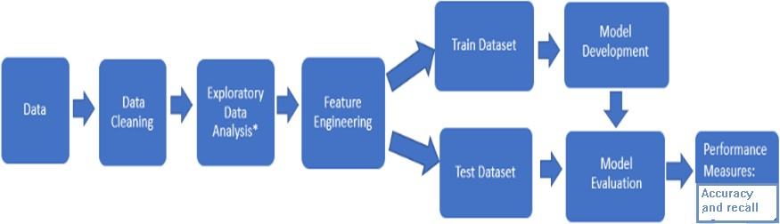
Methodology

Slide 9

EXPLORATORY DATA ANALYSIS
Exploratory Data Analysis refers to the critical process of performing initial investigations on data so as to discover patterns, to spot anomalies, to test hypothesis and to check assumptions with the help of summary statistics and graphical representations.

Slide 10
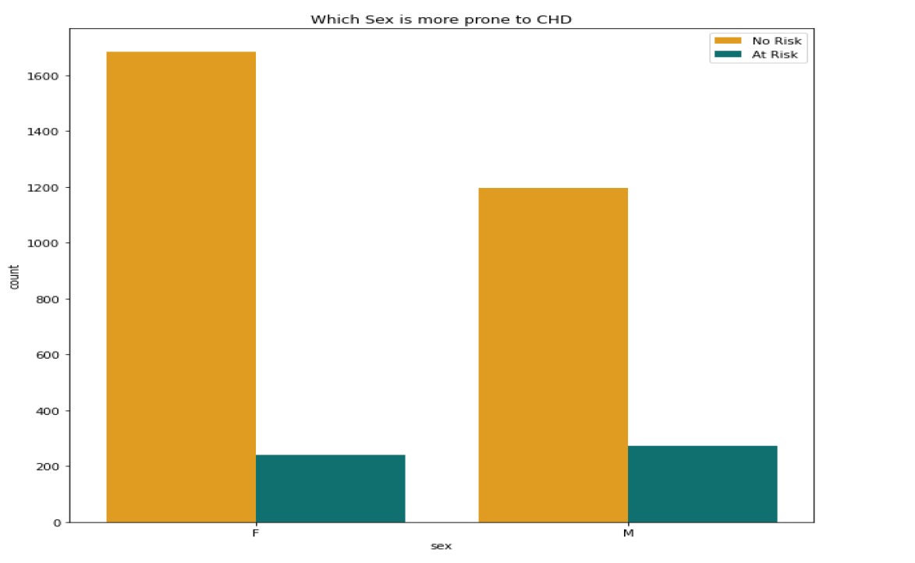
Which gender is prone to coronary heart disease?

Slide 11
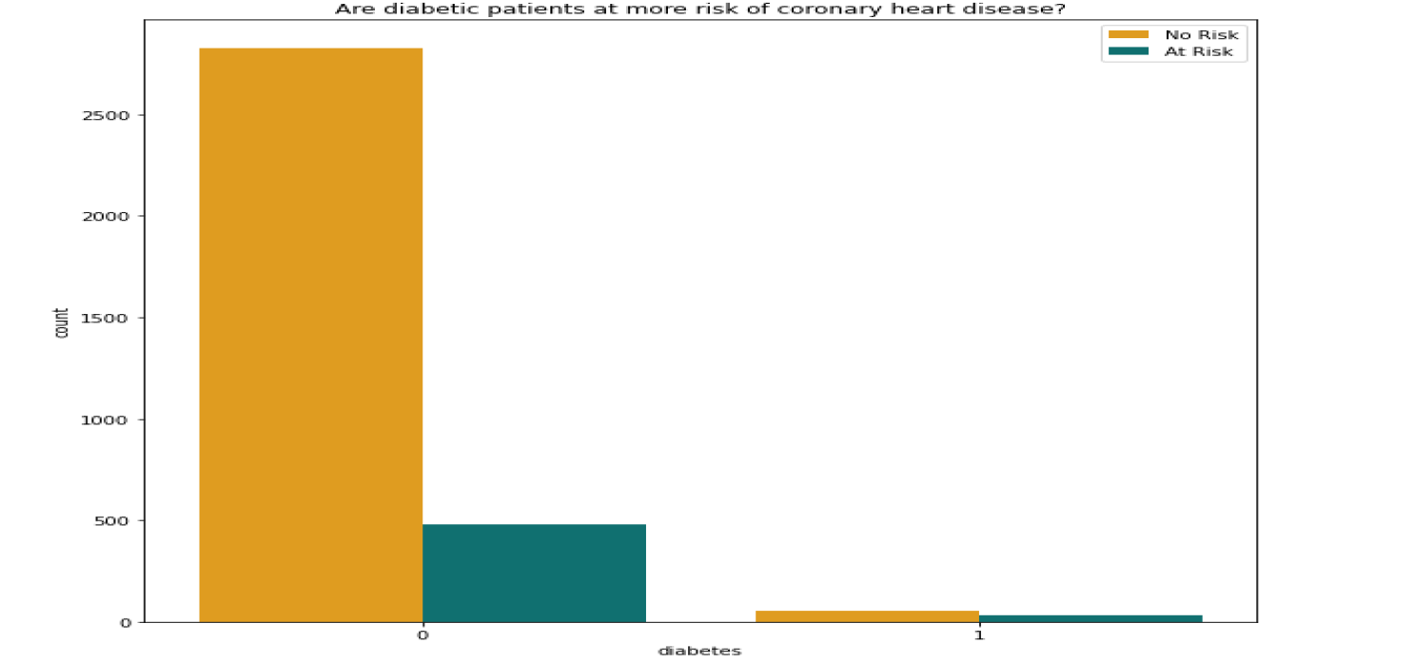
Are diabetic patients at more risk of coronary heart disease ?

Slide 12
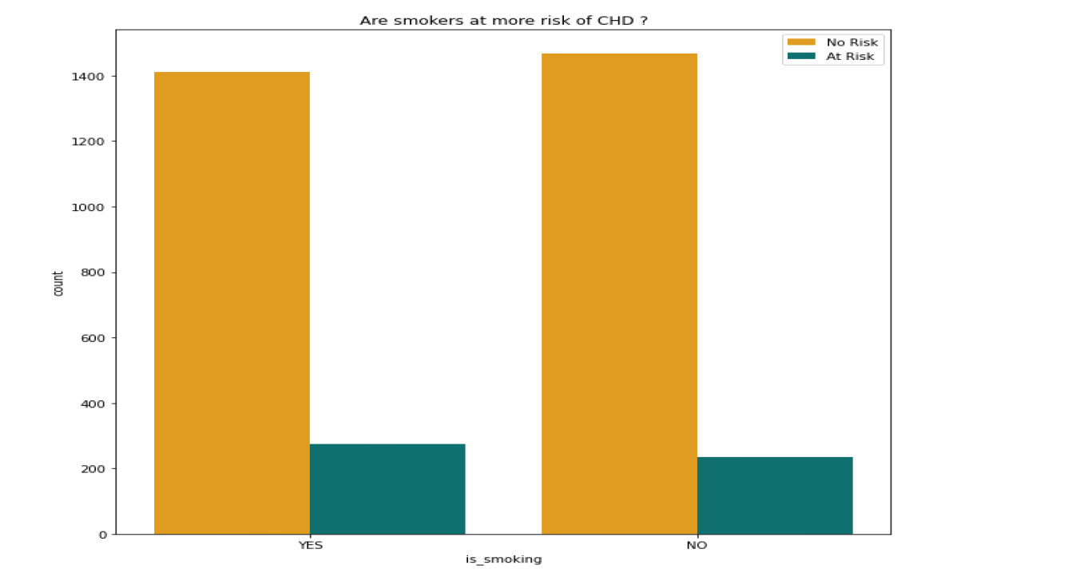
Are smokers at more risk of coronary heart disease ?

Slide 13
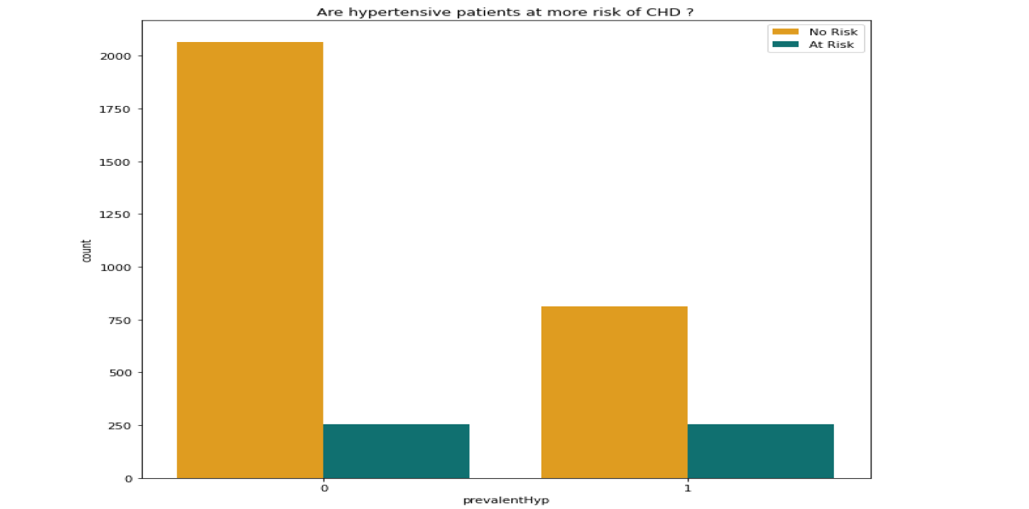
Are hypertensive patients at more risk of coronary heart disease ?

Slide 14
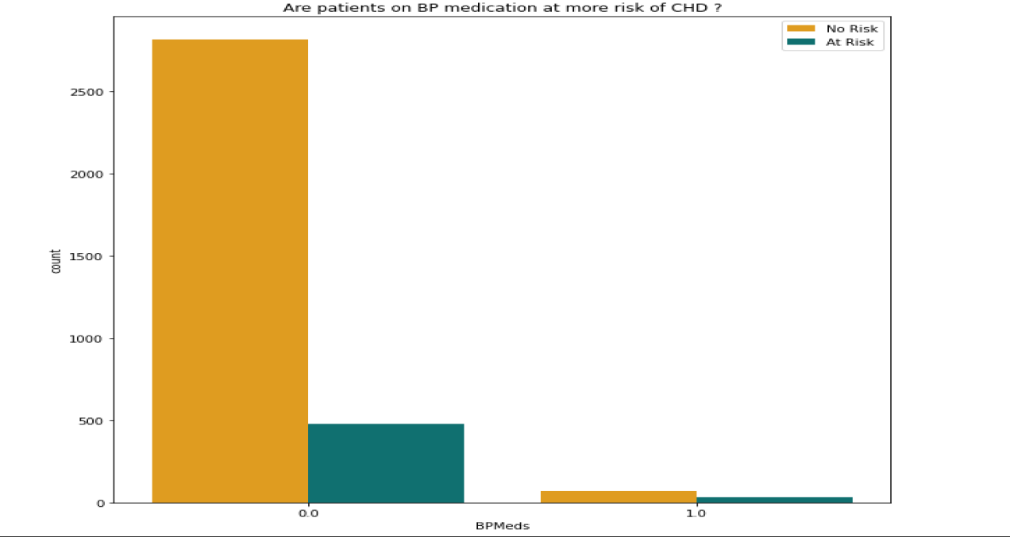
Are patients with blood pressure on medication at more risk of coronary heart disease ?

Slide 15
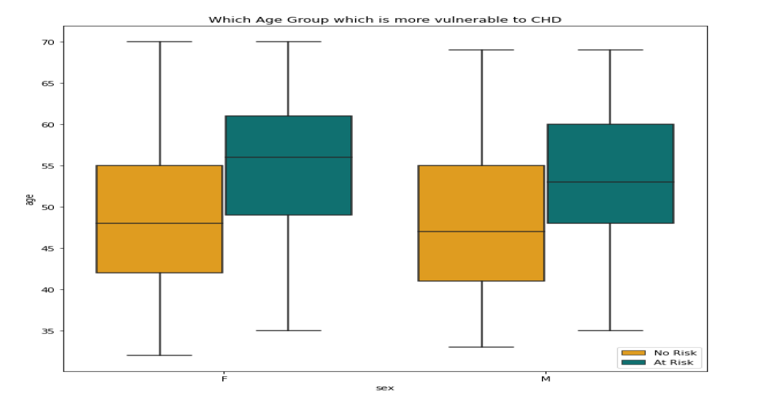
Which Age group is more vulnerable to coronary heart disease ?

Slide 16
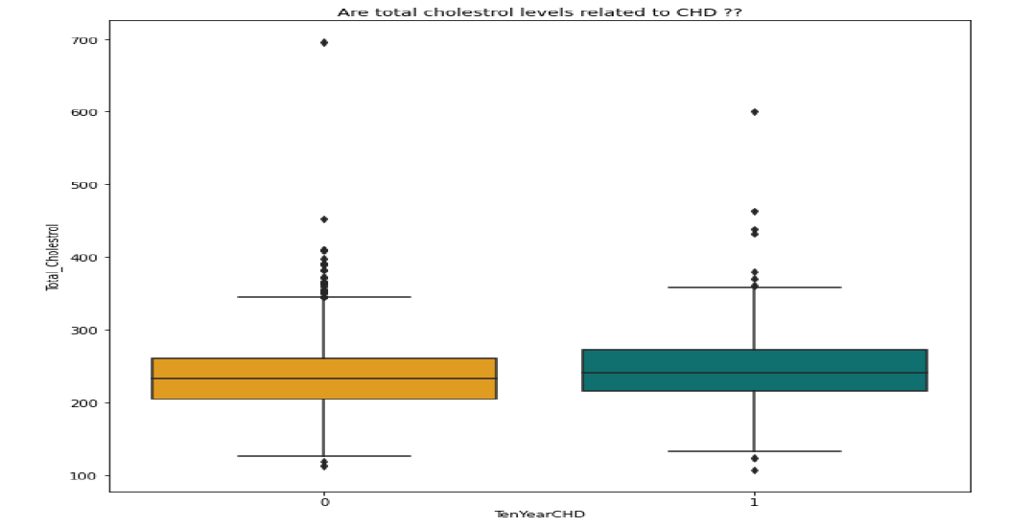
Are Total Cholestrol levels related to coronary heart disease ?
This indicates that cholestrol level is not the sole deciding factor for predicting whether the person gets coronary heart disease or not. People with similar levels of cholestrol have got coronary heart disease as well as are free from coronary heart disease. Clearly, there is no direct correlation of coronary heart disease with the cholestrol level.

Slide 17
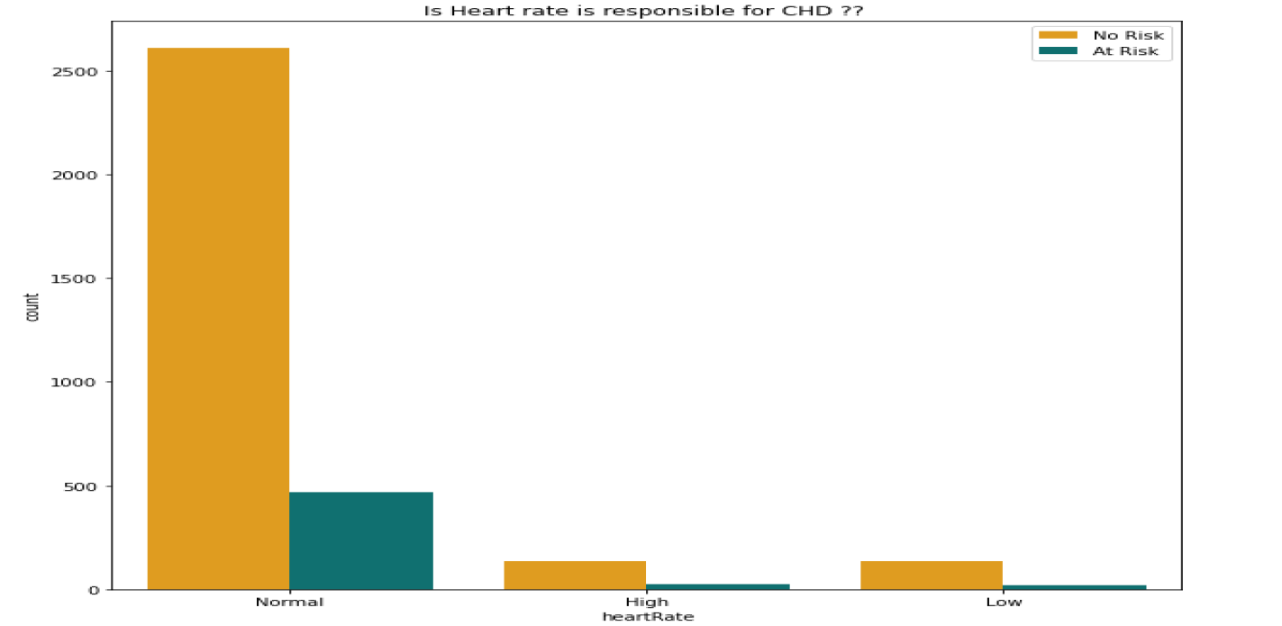
Is Heart rate is responsible for CHD ?

Slide 18
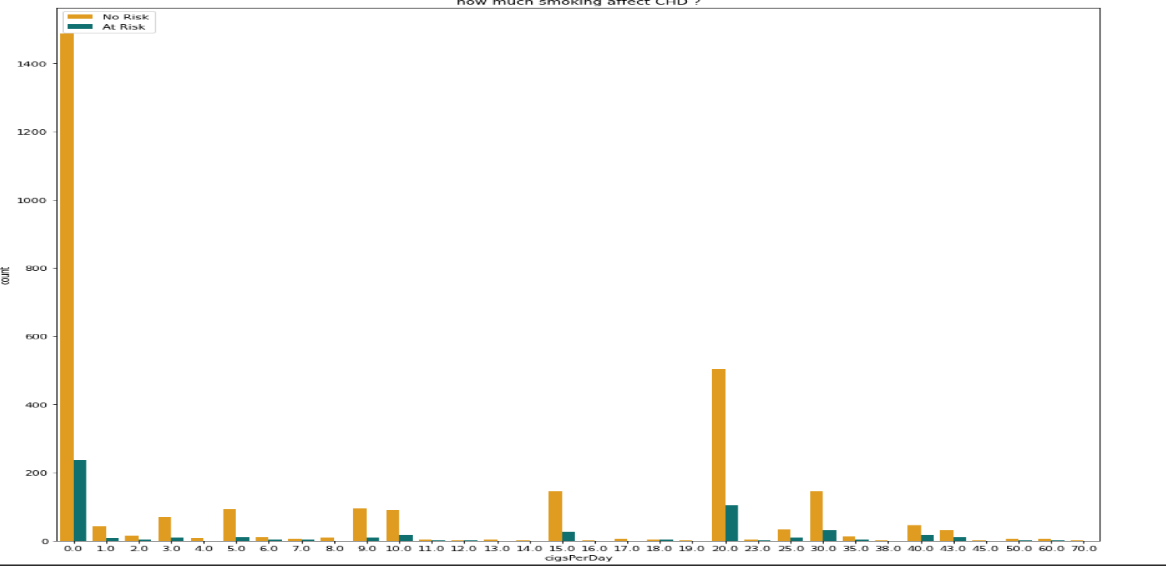
how much smoking affect CHD?

Slide 19
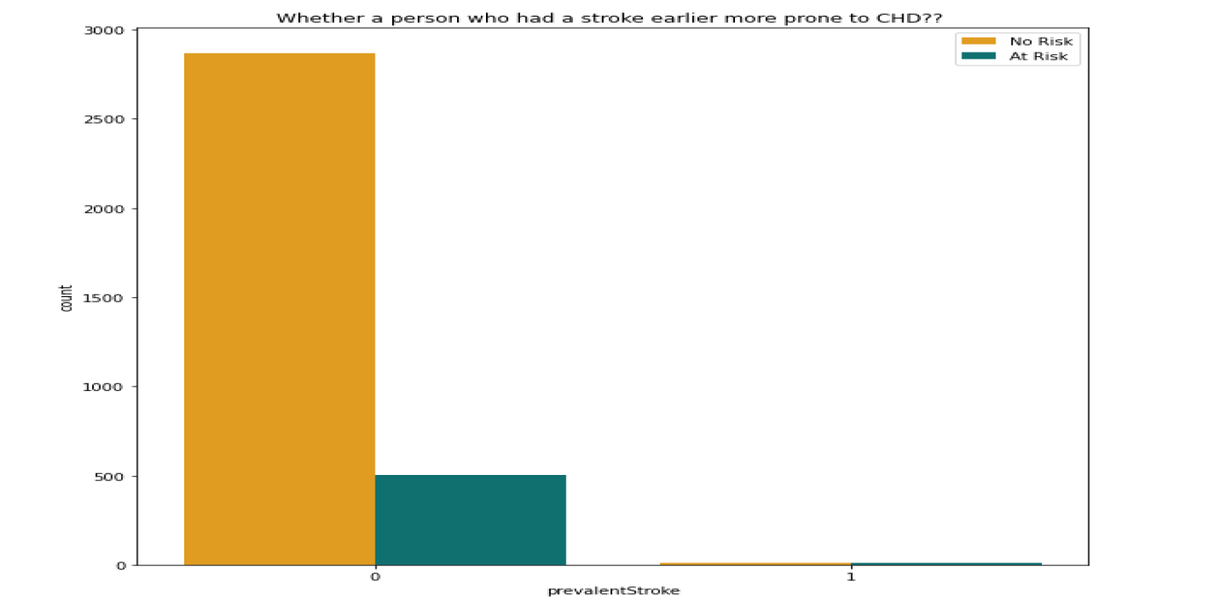
Whether a person who had a stroke earlier more prone to CHD?

Slide 20
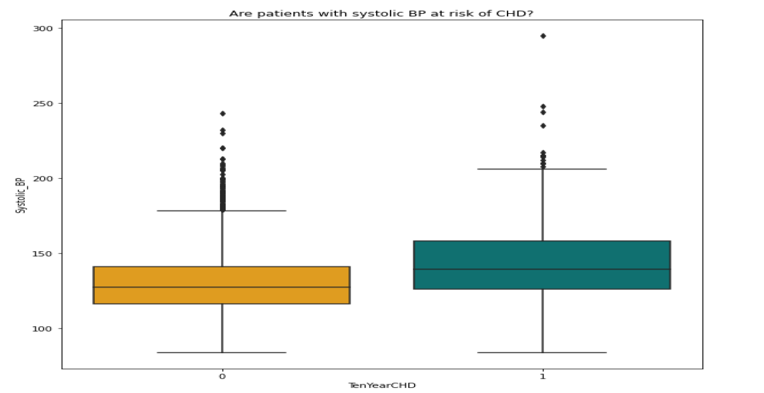
Are patients with systolic BP at risk of CHD?

Slide 21
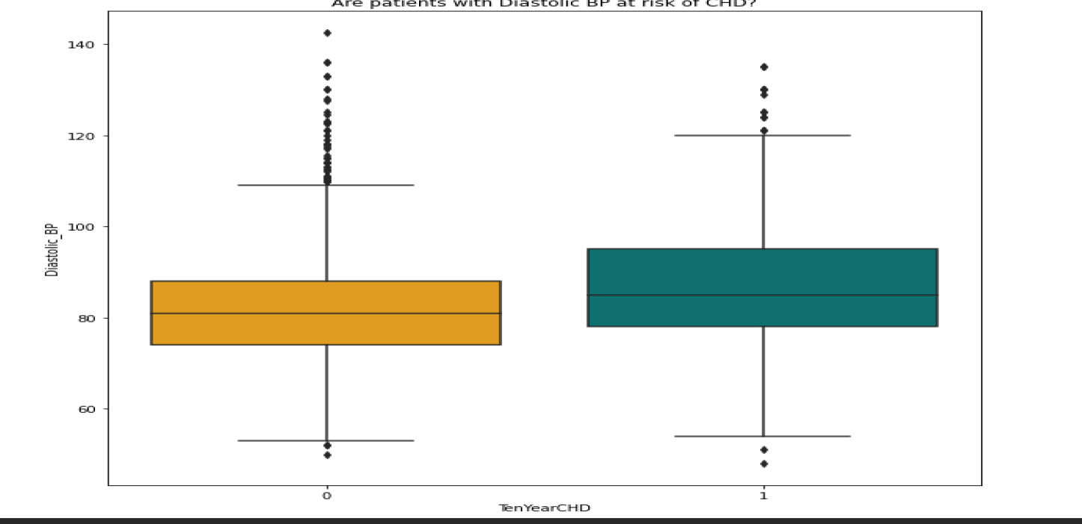
Are patients with Diastolic BP at risk of CHD?

Slide 22
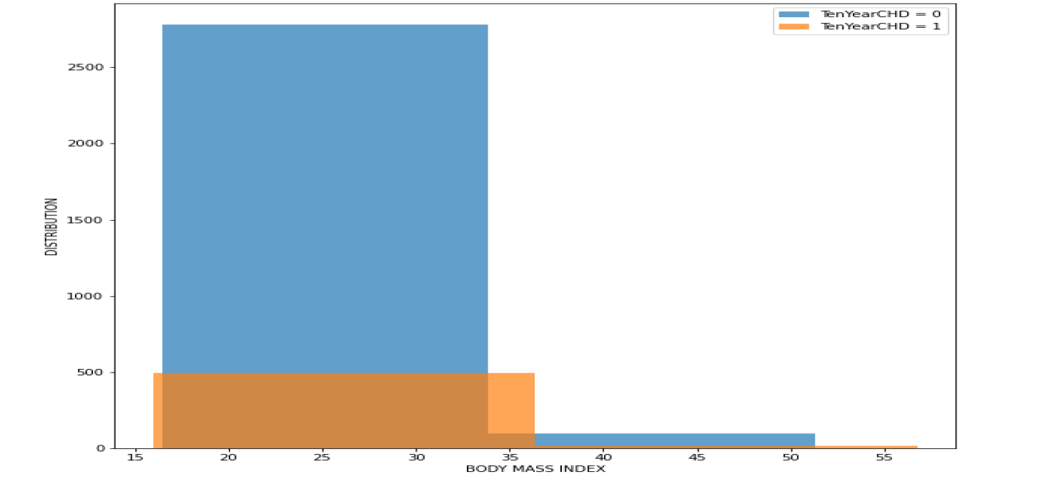
Is patients BMI important to show the risk of CHD?

Slide 23
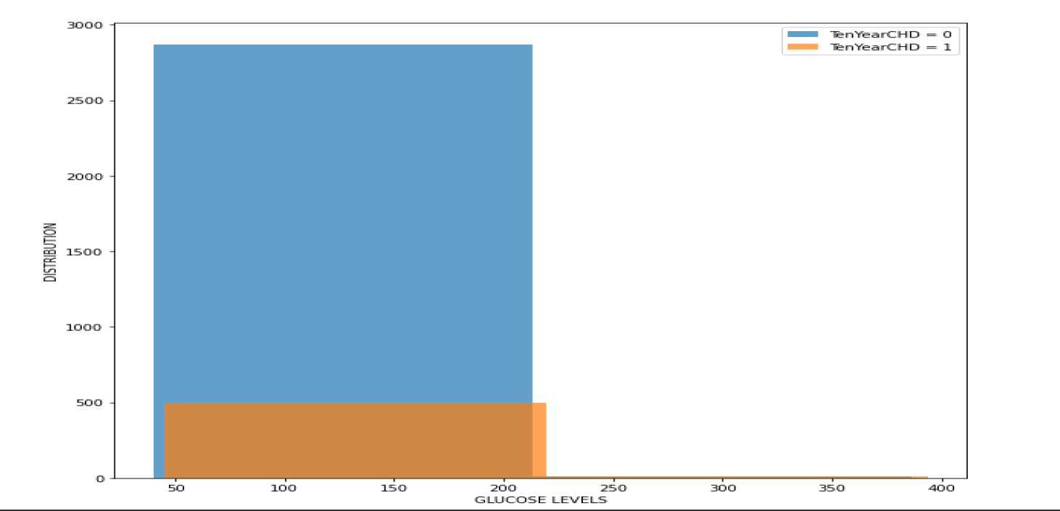
Can patients Glucose levels show the risk of CHD?

Slide 24
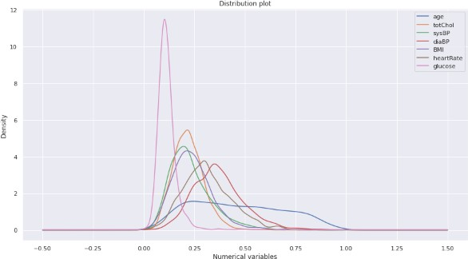
Conclusions of EDA:
Slightly more males are suffering from CHD than females.
The people who has high BMI are at risk of CHD.
The people with hypertension are at highrisk of CHD.
The percentage of people who have CHD is almost equal between smokers and non smokers.
The uneducated people or the people with basic education are at high risk of CHD compared with well educated.

Slide 25
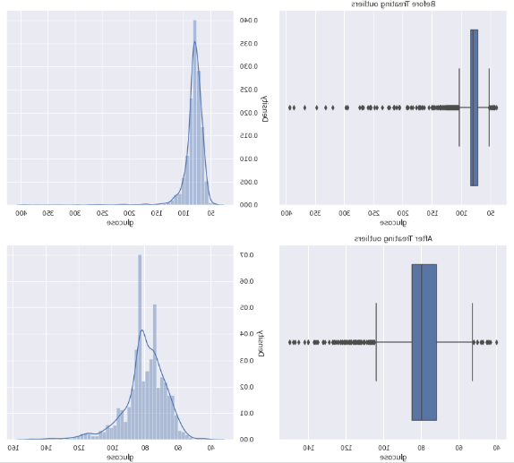
Treatment of Missing Values and Outliers
Treatment of missing values:
There are 6 columns with missing
values.
All the missing values are treated with mean and mode except the ‘glucose’ column.
In glucose column, there are 9% of missing values. So we try dealing with this column from KNN imputation.
Treatment of Outliers :
Outliers treatment in this data set is treated by z score.

Slide 26
Feature Engineering
Feature engineering is the process of selecting, manipulating, and transforming raw data into features that can be used in supervised learning.
Feature Engineering consists of various process :
Feature Creation (2) Transformation (3) Feature Selection
Feature Creation: Creating features involves creating new variables which will be
most helpful for our model.
Transformations: Feature transformation is simply a function that transforms features from one representation to another(Normal distribution). We have used
Box-cox and log transformation to convert columns to Normal distribution.
(1) Feature Selection: Feature extraction is the process of extracting features from a data set to identify useful information. We have used f-regression to do the feature selection.

Slide 27
Feature Engineering
After the process of feature creation, feature transformation and feature selection, we use the one hot encoding to encode all categorical variables.
Later we carry out the standardization technique of minmax scaler to normalize the data.
Now we are all set with the dataset, so at last we check the multicollinearity of the columns. We keep only those columns which are having less or no correlation.

Slide 28
Building model
Before building the models, we perform the train test split. We have taken 70% of the data as train data and 30% of the data as test data.
There are many classification models available in supervised machine learning. The
models which we have used are,
Logistic regression
Decision Tree
Random Forest
K – nearest neighbor
Naïve Baye’s
Adaboost
Support Vector Machine (SVM)

Slide 29
Classification Models
Logistic regression : Logistic regression is a process of modeling the probability of a
discrete outcome given an input variable.
Decision Tree : A decision tree is a mechanical way to make a decision by dividing the inputs into smaller decisions. The tree is divided into decision nodes and leafs. It is based on the concept of entropy.
Random Forest : Random forests or random decision forests are an ensemble learning method for classification, regression and other tasks that operates by constructing a multitude of decision tree at training time.
K – nearest neighbor : K-NN algorithm stores all the available data and classifies a
new data point based on the similarity. This means when new data appears then it can be easily classified into a well suite category by using K- NN algorithm.

Slide 30
Classification Models
5. Naïve Bayes classifiers : Naïve Bayes classifiers are a family of simple “probabilistic clasifiers” based on applying Bayes theorem with strong independence assumptions between the features.
6. Adaboost classifiers : An AdaBoost classifier is a meta-estimator that begins by fitting a classifier on the original dataset and then fits additional copies of the classifier on the same dataset but where the weights of incorrectly classified instances are adjusted such that subsequent classifiers focus more on difficult cases.
7.Support Vector Machine (SVM) : “Support Vector Machine” (SVM) is a supervised machine learning algorithm that can be used for both classification or regression challenges. Here we plot each data item as a point in n-dimensional space with the value of each feature being the value of a particular coordinate. Then, we perform classification by finding the hyper-plane that differentiates the two classes very well.

Slide 31
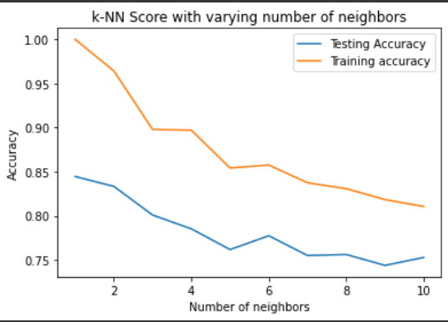
K-nn score with varying number of neighbors

Slide 32
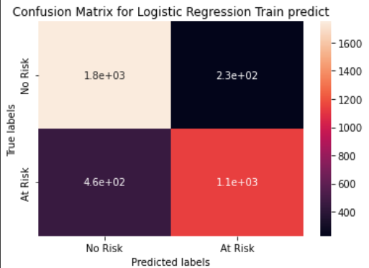
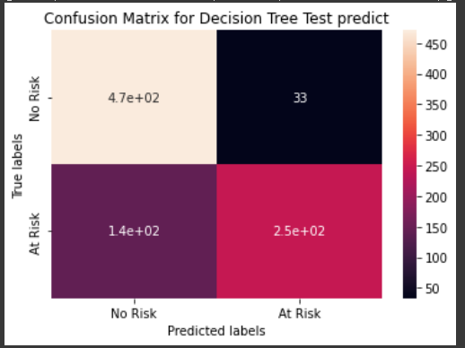
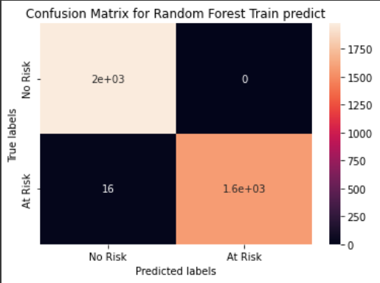
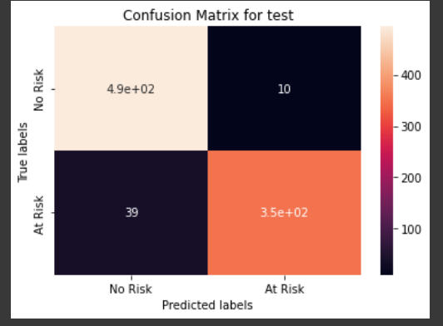
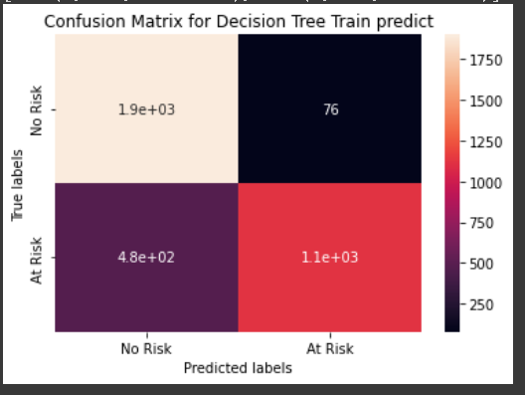
Confusion matrix

Slide 33
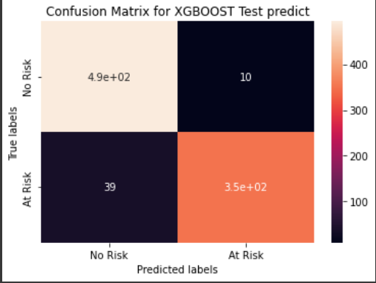
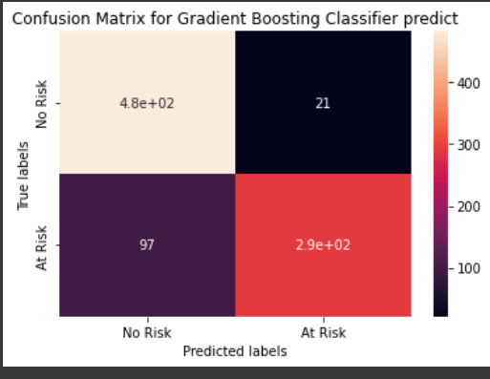
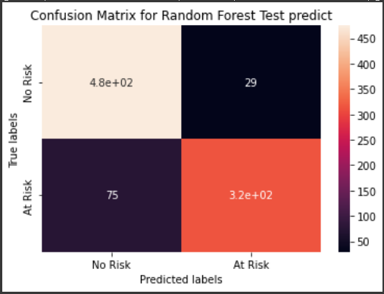
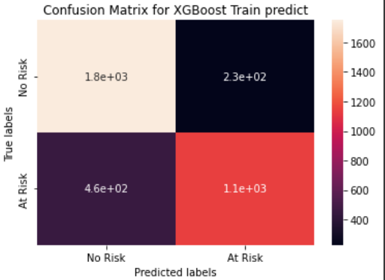
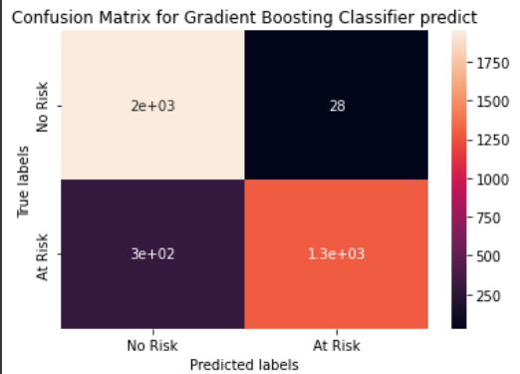
Confusion matrix

Slide 34
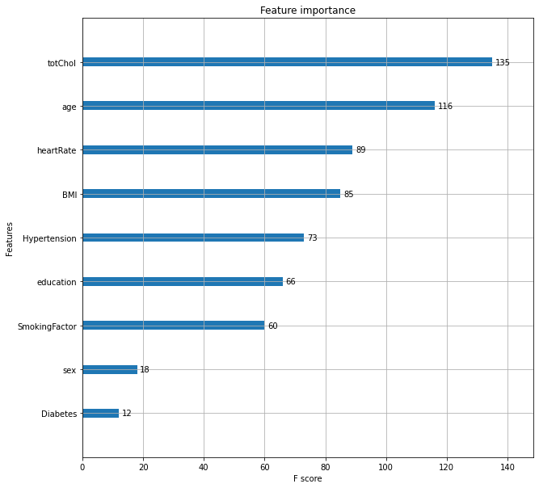
THE FEATURE IMPORTANCE

Slide 35

Precision and Recall
Precision is the proportion of relevant results in the list of all returned search results.
Recall is the ratio of the relevant results returned by the search engine to the total number of the relevant results that could have been returned.
In this project we are giving more importance to recall because predicting that the person does not have a disease when he have one can risk that person's life.

Slide 36
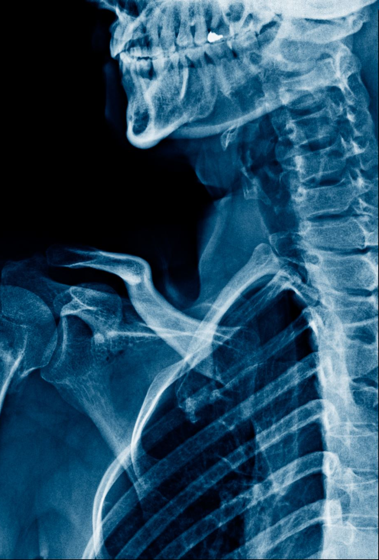
Challenges:
Less amount of data available made it difficult to predict properly.
Missing relevant/Important features in our dataset like Chest pain location, chest pain type, Family history of coronary artery, Exercise, etc.
The dataset was imbalanced and hence we were not able to apply some models properly.

Slide 37
Conclusions
A cardiovascular disease detection model has been built using number of ML
classification modelling techniques.
This project once deployed can possibly help predict the patients for
cardiovascular disease based to their past medical history Blood
pressure, Body mass index, Sugar levels etc.
The algorithms used in building the model are Logistic regression,
Decision trees, KNN, Random forest classifier, Naive bayes classifier,
Gradient boost and XG boost.
The top three models with best accuracy are Gradient boost, Random
forest & XG boost with accuracy of 87%, 89%,and 97% respectively.

Slide 38
Conclusions
To conclude we started with loading the data So far we have done.
EDA, null values treatment, encoding of categorical columns, feature selection and then model building.
In all of these models our accuracy revolves in the range of 75 to 97 and there is no such improvement in accuracy score even after hyperparameter tuning.
Also it is concluded that accuracy of XG boost is highest as compared to all the algorithms used i.e. 97.
This performance could be due to various reasons like No proper pattern of data, lack of data, not enough relevant features but maybe with enough data we can train our model even better.

Slide 39
THANK YOU

